Slide 1
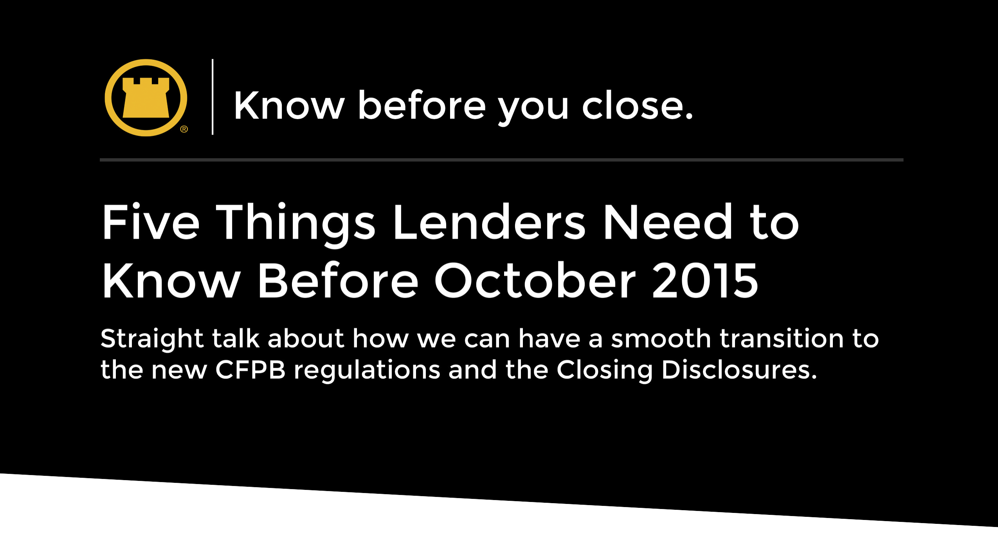

© 2015 Fidelity National Title Group

Slide 2
Five Things You Need to Know
Before August 2015
^{Five Things to Know:}
Who will prepare the new Closing Disclosure?
Who will deliver the Closing Disclosure?
How will settlement agents and lenders communicate data?
Who will make changes to the Closing Discloser?
How will settlement agents communicate title and settlement fees?
© 2015 Fidelity National Title Group

Slide 3
Five Things You Need to Know
Before August 2015
1. Who will be responsible for preparation of
the new closing disclosure?
The new CFPB rule provides that the lender is ultimately responsible for preparation of the Closing Disclosure.
The rule also allows the lender to delegate some or all of the preparation to the settlement agent.
Determining which system will create the final form is important in establishing workflows for the transfer of information.
© 2015 Fidelity National Title Group

Slide 4
Five Things You Need to Know
Before August 2015
2. Who will be responsible for the delivery of
the new closing disclosure?
Borrower must receive a copy of the CD three days prior to “consummation” (most often the date of signing loan documents).
The Rule allows for a settlement agent, at the lender’s discretion, to deliver the CD to the borrower.
Some lenders, as a result of compliance concerns, may opt to deliver the CD themselves.
© 2015 Fidelity National Title Group

Slide 5
Five Things You Need to Know
Before August 2015
3. How will settlement agents and lenders
communicate data?
Not all information on the CD is contained in a single system.
How will we exchange the information needed to complete the Closing Disclosure.
Some lenders have indicated this “collaboration” process will occur electronically.
Others may need to rely on a less automated approach.
© 2015 Fidelity National Title Group

Slide 6
Five Things You Need to Know
Before August 2015
4. Who will make any necessary changes to the
Closing Disclosure?
Changes to numbers contained on the initial CD may occur prior to closing, necessitating adjustments, re-printing and delivery of the corrected CD at signing.
It is important to consider and decide if the party that prepared the initial CD will also make the changes for an amended CD.
Can settlement agents make some changes to a lender-prepared CD?
© 2015 Fidelity National Title Group

Slide 7
Five Things You Need to Know
Before August 2015
5. How will we communicate title and
settlement fees for use in the new forms?
Accurate estimates of title and settlement fees are needed for the preparation of both the Loan Estimate and the Closing Disclosure.
For transactions in which an owner’s policy will be purchased, the Rule prescribes special mathematical calculations for disclosure of the owner’s and lender’s title insurance premiums, which may require receipt of rates for both a stand-alone and simultaneously-issued lender’s policy, as well as the owner’s policy rate.
© 2015 Fidelity National Title Group

Slide 8
Five Things You Need to Know
Before August 2015
Let’s Talk
We are committed to working with you to think through all the implications of the CFPB Rule, so that the transition is as smooth as possible.
So let’s talk, discuss the impacts, and come up with solutions and processes that will be compliant with the new regulations and that will work for you.
© 2015 Fidelity National Title Group

Slide 9
© 2015 Fidelity National Title Group

